Slide 1

FULLY AUTOMATED IRRIGATION SYSTEM
Kasegaon Education Society’s
Rajarambapu Institute of Technology, Rajaramnagar
(An Autonomous Institute)
(Approved by AICTE, affiliated to Shivaji University Kolhapur)
Project Group:
Aditya Desai (1908058)
Shreyas Patil (1908057)
Devika Desai (2058010)
Aishwarya Nagargoje(2058003)
Project Supervisor:
Mr. R. A. Metri

Slide 2
Outline
Introduction
Research Objectives
Research Method
Modelling
Results
Conclusion
Project Plan
References

Slide 3
INTRODUCTION
India's current water levels.
India's current energy consumption by agriculture sector
(20-22% of total energy consumption).
Need
Problem statement
Designing a fully automated irrigation system for efficient use of water and electricity.

Slide 4
RESEARCH OBJECTIVES
To develop an automated irrigation system for efficient management of water and electricity.
To integrate moisture sensor based system with timer based system
To analyze the data by comparing it with the present system and modifying system for efficiency.

Slide 5
RESEARCH METHOD : CURRENT TECHNOLOGIES
CURRENT TECHNOLOGIES
Timer Based
Timer decides on and off of motor
motor turned on after completing of 1 Timer
Motor turns off after completing of 2nd Timer.
Timer Based
Turning on and off of motor is decided by moisture sensor.
Motor turns on if moisture sensor detects no water in soil.
Motor gets off when moisture sensor detects water

Slide 6
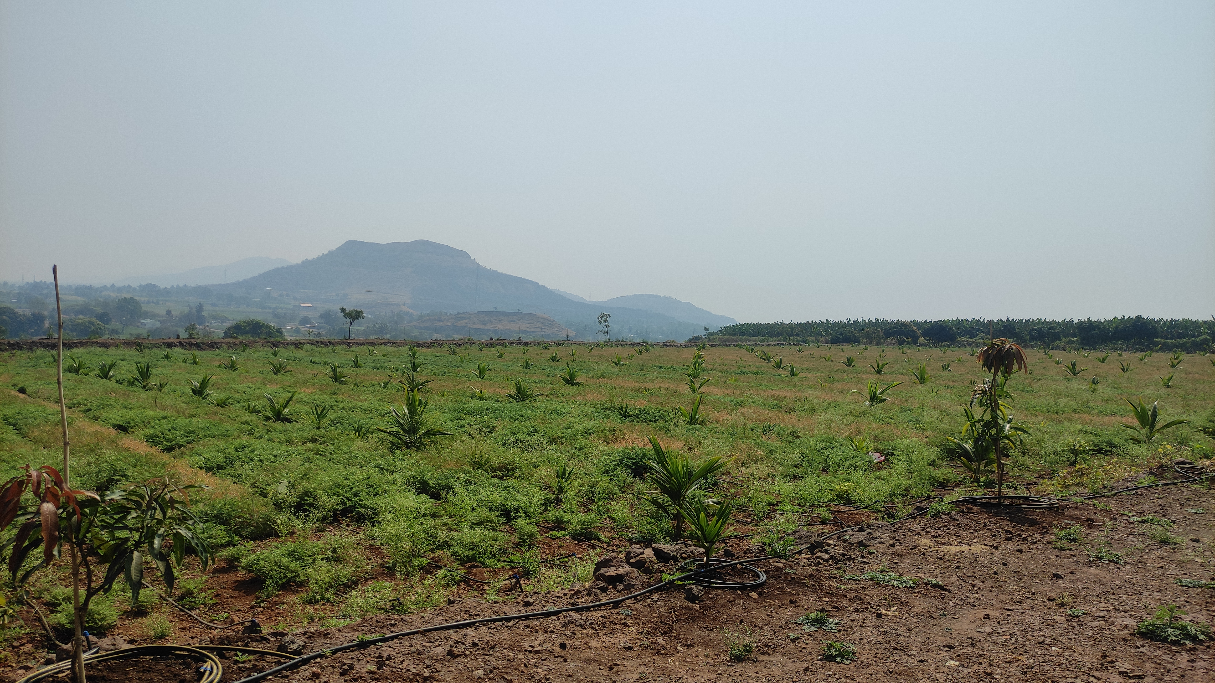
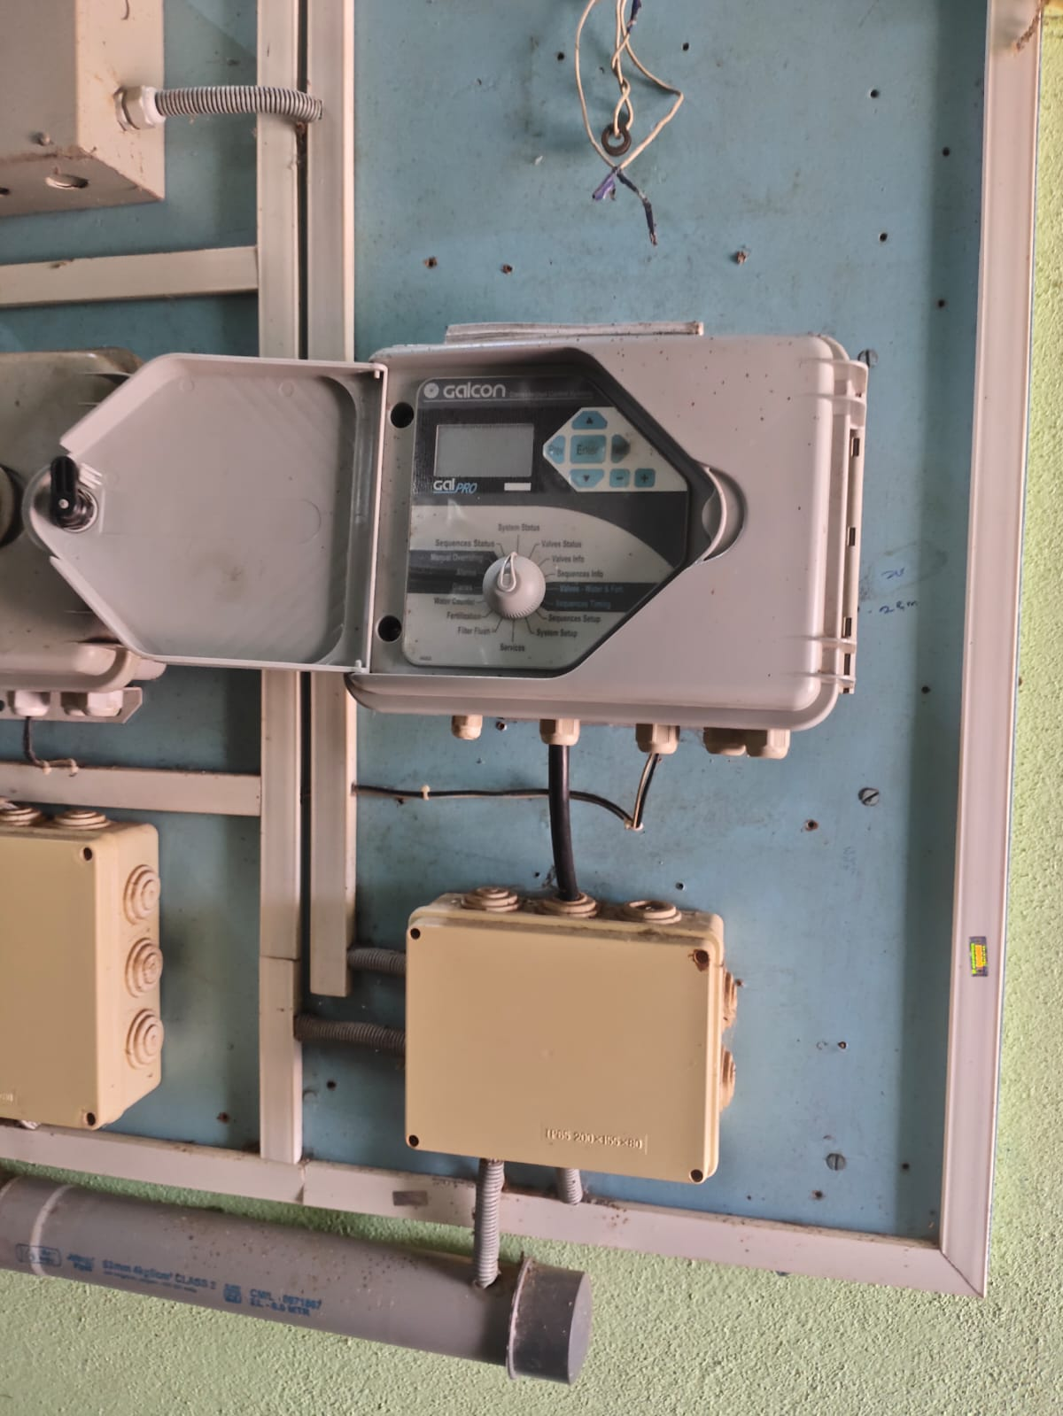
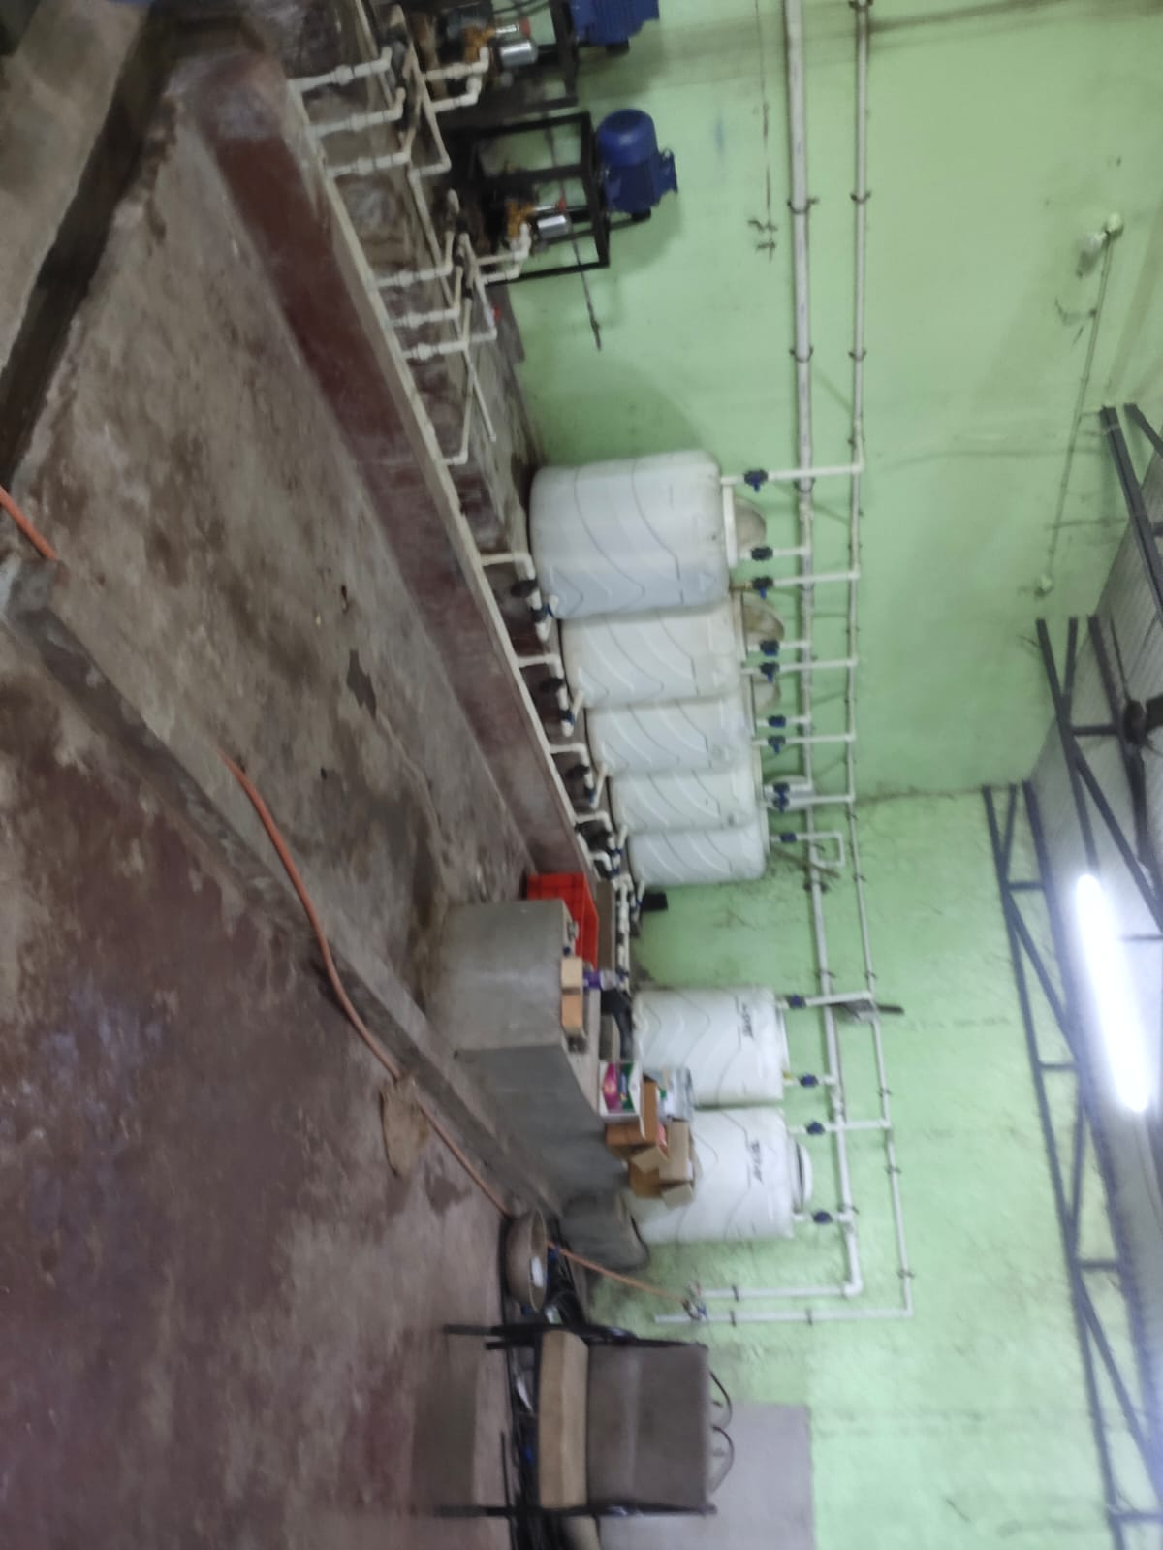
RESEARCH METHOD : SURVEY
VISIT TO SUMAN AGRO :
OPEN FIELD AUTOMATION
CONTROL PANEL
DISTRIBUTION HUB

Slide 7
RESEARCH METHOD : DEMERITS
TIMER BASED
Soil behaves differently in different climates.
Need of water is different for different time.
We can set timer only ones no automatic control over water level in the soil .
Open loop system - Therefor NO FEEDBACK
MOISTURE BASED
We cant rely only on the data given by moisture sensor.
As soon as water touches sensor motor turns off.
Only applicable for smaller models.
RESEARCH METHOD : OUR SOLUTIONS
Integration Of Timer And Moisture Sensor
Provide full life cycle irrigation plan for particular plant

Slide 8
RESEARCH METHOD
FLOW OF THE PROJECT:
Making RTC based system.
Making moisture based system.
Integrating both .
Make schedule for some other crops.
Test on testbench .
Compare results.
Conclusion.

Slide 9
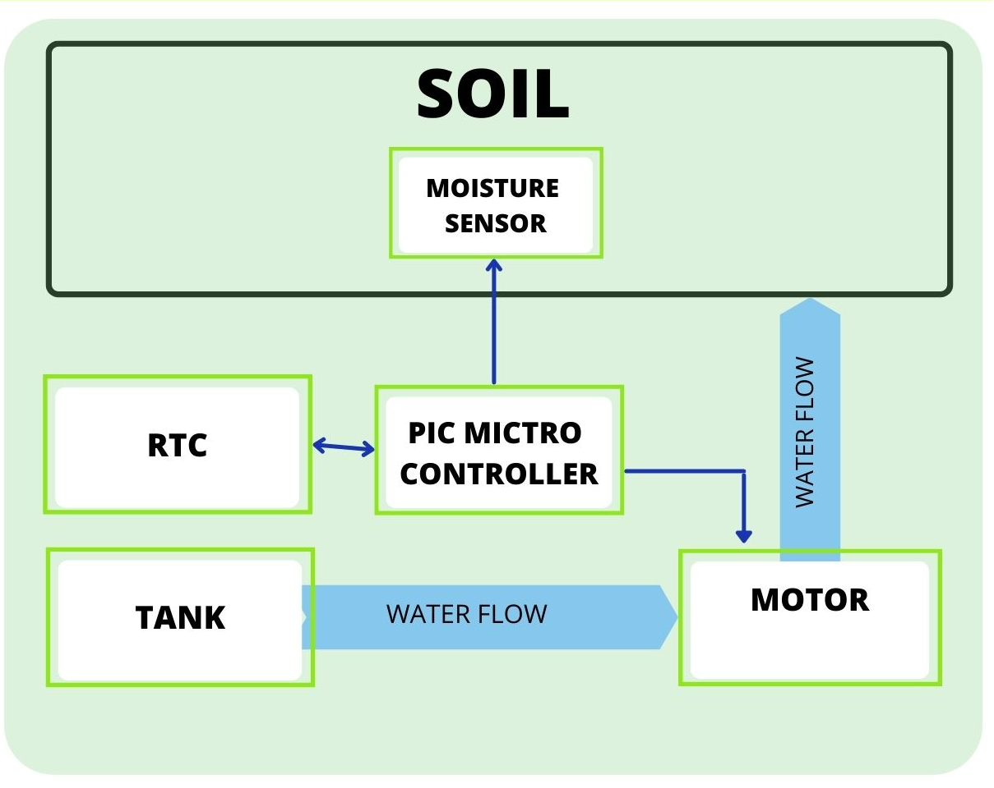
MODELLING : BLOCK DIGRAM OF OVERALL SYSTEM

Slide 10
MODELLING : COMPONENTS SPECIFICATIONS
MICROCONTROLLER
DISPLAY
MODEL : PIC 18F4520
(2.5V – 5.5V)
(5.8 Micro Amp)
MODEL : 16*2
(4.7 V to 5.3 V)
(1mAmp)
RTC MODULE
RELAY
MODEL : DS 3231
(2.2V TO 5.5V)
(100-170 micro Amp)
Nominal Voltage: 12V
Coil resistance: 270Ω
Max Current: 5A
MOISTURE SENSOR
MODEL : DS 3231
(3.3V)
(5 m Amp)

Slide 11
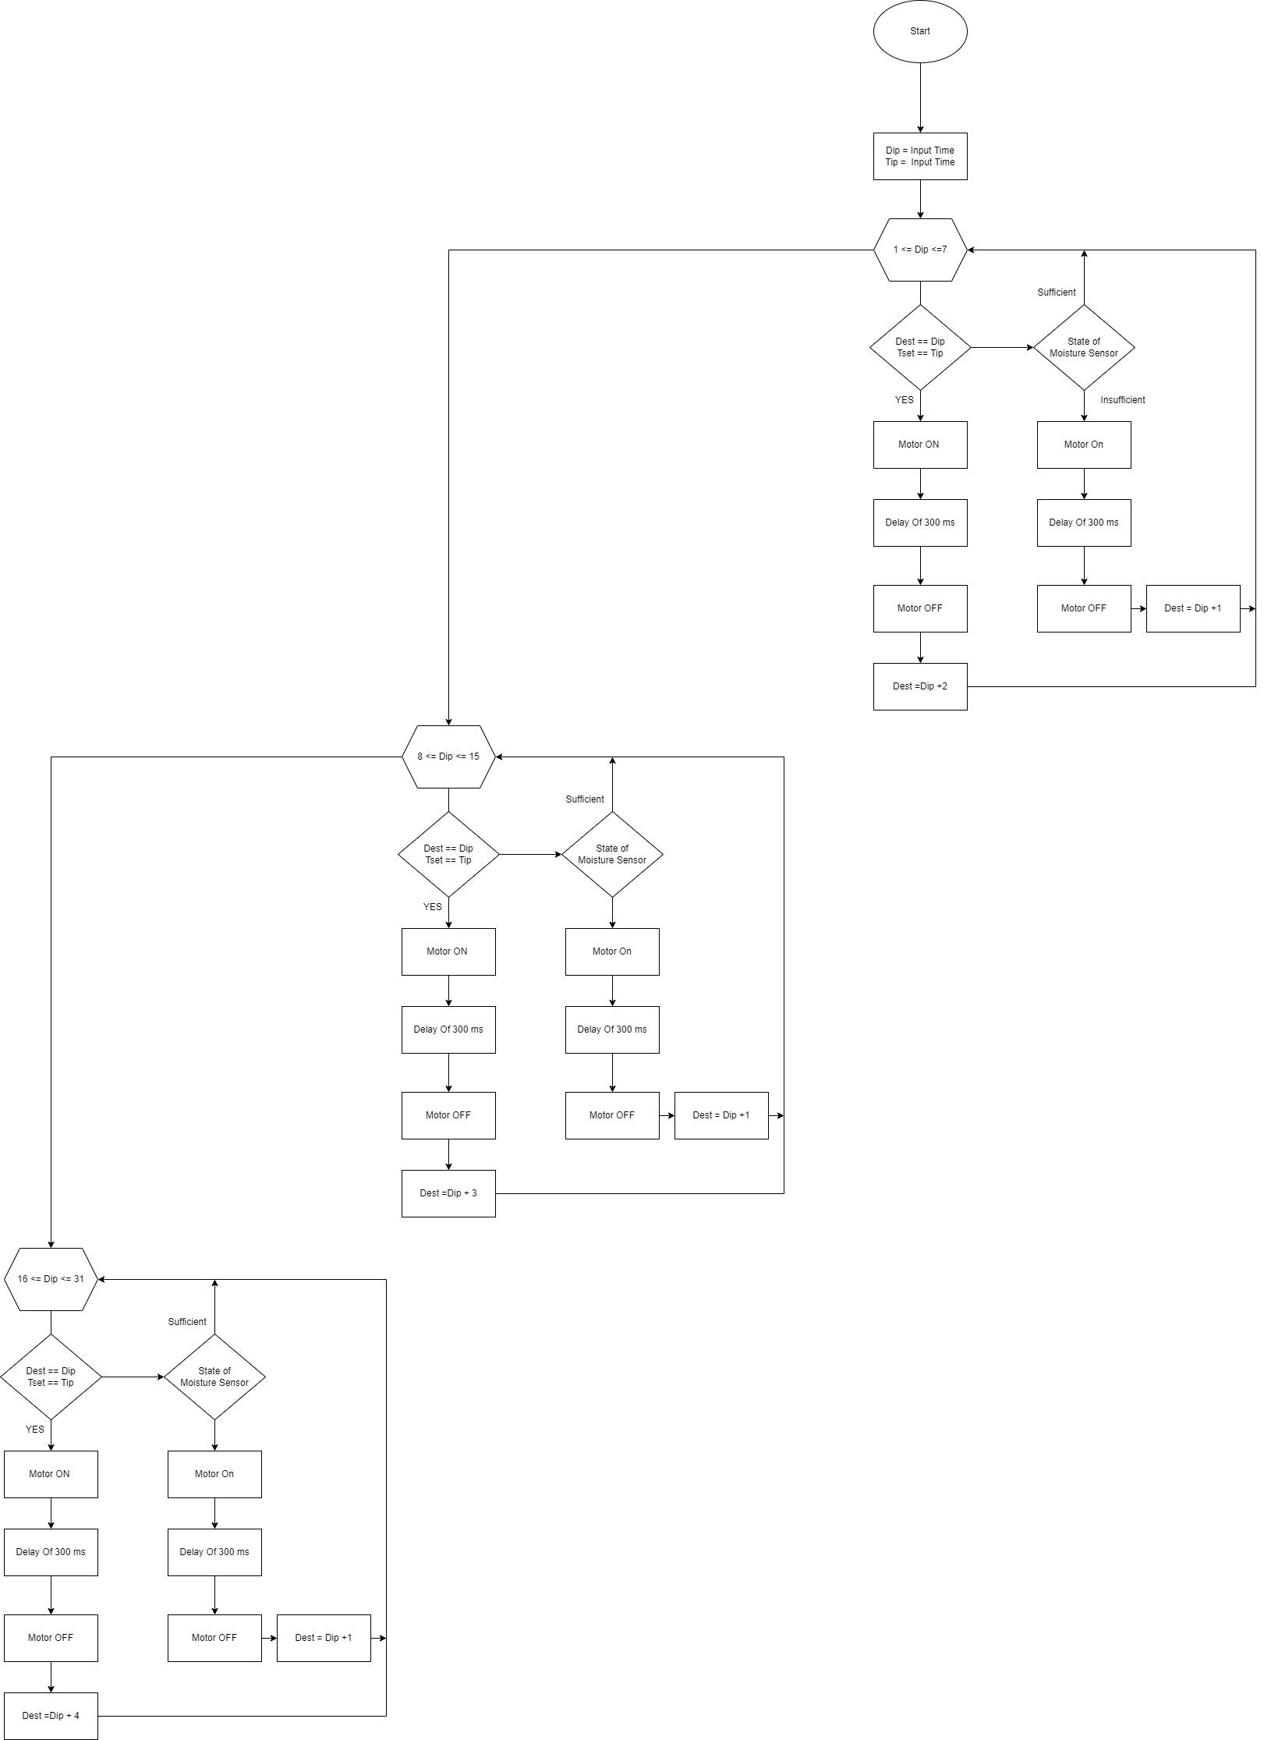
MODELLING : BLOCK DIGRAM OF PERTICULAR CROP CORIENDER
BLOCK DIGRAM OF PERTICULAR CROP : CORIENDER
A
B
A
FALSE
FALSE
FALSE
B
TRUE
TRUE
TRUE
FALSE
FALSE
FALSE
TRUE
TRUE
TRUE
END

Slide 12
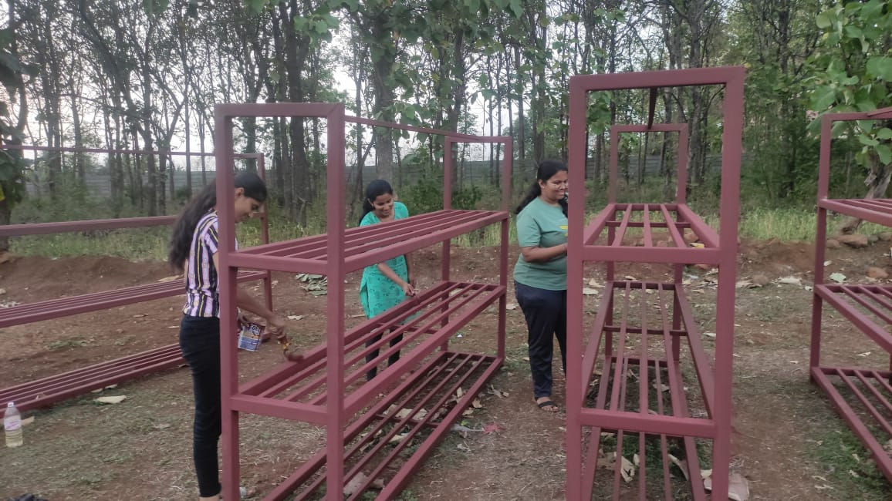
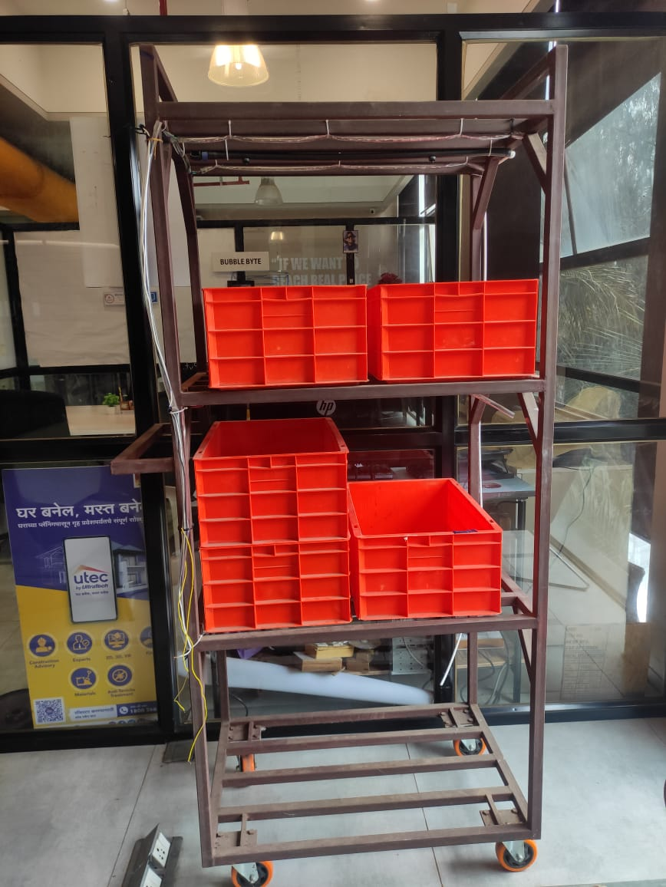
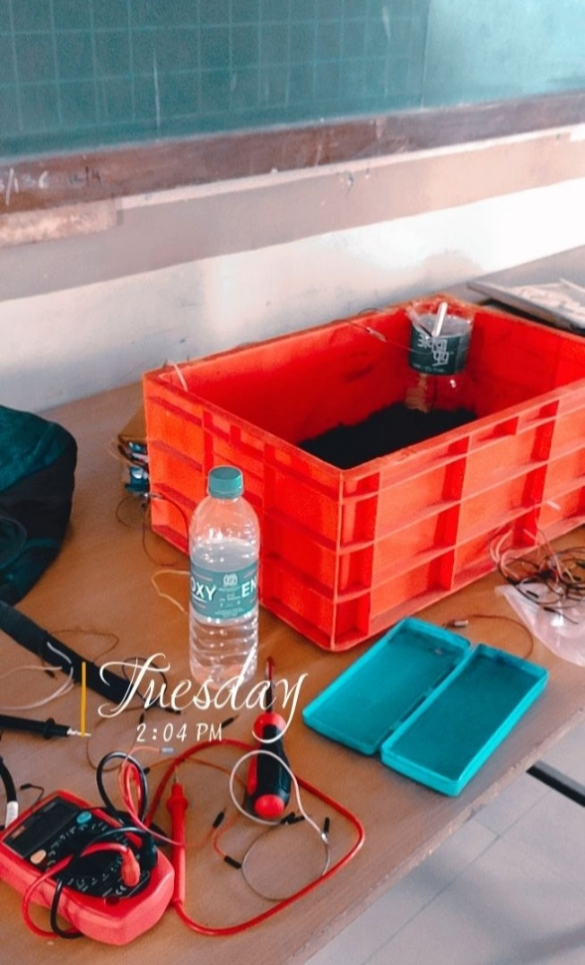
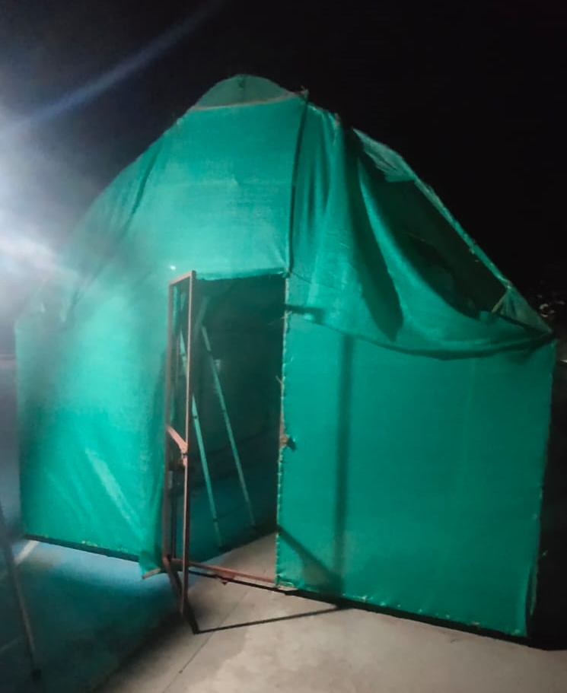
MODELLING : WORK DONE
MAKING OF TEST BENCH
MODEL PRESENTED
IN B.I. COMPETETION SANGALI
MAKING OF MODEL D
MAKING OF GREENHOUSE
DIMENTIONS
14’*10’*9’

Slide 13
IMPLICATIONS
GREEN HOUSES AND POLY HOUSES
SHEDULE CAN BE IMLEMENTED IN THE AUTOSWITCH
HOUSEOLD FARMING
GREEN BUILDINGS
GARDERNS

Slide 14
CALCULATED RESULT
Total power used by 1 tray in one hour : 1 watt
12 volt motor : 60 watts
So total power - consumed by the rack = 60+1 = 61 watt per hour
For green house 6*61 = 366 watt per hour
If we turn on motor for 30 mins a day = 183 Watt
For a month 183*30 = 5490 Watt Hr = 5490 / 1000 = 5.490 unit
total running cost = 5.36*5.490 = 29.42 Rs

Slide 15
BENIFITS
REDUCE HUMAN EFFORTS
REDUCES
ELECTRICITY USES
REDUCE WATER
WASTAGE
COSTEMIZABLE
PORTABLE

Slide 16
CONCLUSION
PIC 18f4520 is used to control all the processes.
Microcontroller turns on the motor according to the schedule while also reads the data provided by moisture sensor.
It regulates the flow of water according to Schedule and if Moisture sensor detects deficiency of water it overrules the system and gives command to motor to turn on.

Slide 17
PROJECT PLAN
SN | Task | Academic Year 2022-23
 |  | Feb | Mar | Apr | May | June | July | Aug | Sept | Oct | Nov
1 | Literature Survey
2 | Theoretical Study
3 | Design and Development
4 | Experimental setup preparation
5 | Testing & Measurement
6 | Analysis and verification
7 | Presentation
9 | Report writing

Slide 18
References
[1] | Mehamed Ahmed Abdurrahman (2015) Sensor Based Automatic Irrigation Management System : International Journal of Computer and InformationTechnology (IJCIT) , Vol. 04, Issue. 03, pp. 05-15.
[2] | Bishnu Deo Kumar, Prachi Shrivasthav, Reetika Agrawal and Vanya Tiwari (2017), Microcontroller based automatic plant irrigation system : International Research Journal of Engineering and Technology (IRJET), Vol. 04, Issue. 05, pp. 05-17.
[3] | Raja. G, Abhiraj. R, Arunkrishnan, Febin Malik, Jesu Jorof Divin. J and Rajarathinum (2018), Smart Polyhouse Farming Using Iot Enviroment:International Journal Of Trend in Scientific Reasearch and Development (IJTSRV) , Vol. 02, Issue. 03, pp. 03-18.
[4] | R.Nageswara Rao, B.Sridhar(2018) IOT Based Crop Filed Monitoring And Automation Irrigation System: second international coferance on inventive system and control(ICISC)
[5] | G.K.Banerjee,Rahul Singhal(2010)Microcontroller based polyhouse automation controller.(International symposium on electronic system design)

Slide 19

THANK Y U

